Slide 1

Computer Graphics
Deepankar Sharma

Slide 2
Introduction to Computer Graphics: • Definition, • Applications, • Graphics Hardware, • Display Devices: § Refresh Cathode Ray Tube, § Raster Scan Display, § Plasma display, § Liquid Crystal display, § Plotters, § Printers.

Slide 3




































Definition

Slide 4














Definition
It is the use of computers to create and manipulate pictures on a display device. It comprises of software techniques to create, store, modify, represents pictures.

Slide 5
Applications
User Interfaces
Plotting Graphs and Charts
Office Automation and Desktop Publishing
Computer Aided Designing and Drafting
Simulation and Animation
Art and Commerce
Process Control
Cartography

Slide 6























Important Terms
Pixel
Resolution
PPI
Aspect Ratio
Frame Buffer

Slide 7


























Scan Conversion and Rasterization

Slide 8









































Graphics Hardware

Slide 9






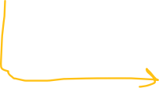











































Cathode Ray Tube(CRT)

Slide 10



















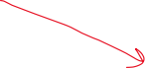









Rastor Scan Display

Slide 11
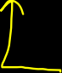













































Vector Scan Display

Slide 12
















































































Slide 13




















































Interlacing

Slide 14












































































Beam Penetration
Shadow Masking

Slide 15







































Flat Panel Display

Slide 16



































































Plasma Display

Slide 17








































LED

Slide 18






































































LCD

Slide 19














































































LED vs LCD

Slide 20
Mathematics of Computer Graphics: • Point representation, • Vector representation, • Matrices and operations related to matrices, • Vector addition and vector multiplication, • Scalar product of two vectors, • Vector product of two vectors. Parametric equations of lines and conics.

Slide 21






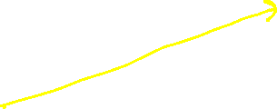



Vectors

Slide 22
Vectors

Slide 23
Line Drawing Algorithms: • DDA algorithms, • Bresenham’s Line algorithm. • Circle and ellipse generation algorithm. Clipping: • Point Clipping, • Line Clipping. • Polygon Clipping. Filling: • Inside Tests, • Flood fill algorithm, • Boundary-Fill Algorithm and • scan-line polygon fill algorithm.

Slide 24

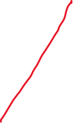















DDA Line Drawing Algorithm

Slide 25







DDA Line Drawing Algorithm

Slide 26

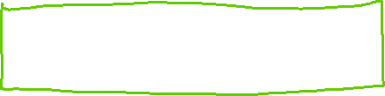

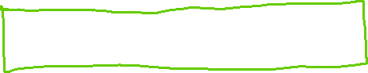

DDA

Slide 27












Bresenham’s Line Drawing Algorithm

Slide 28
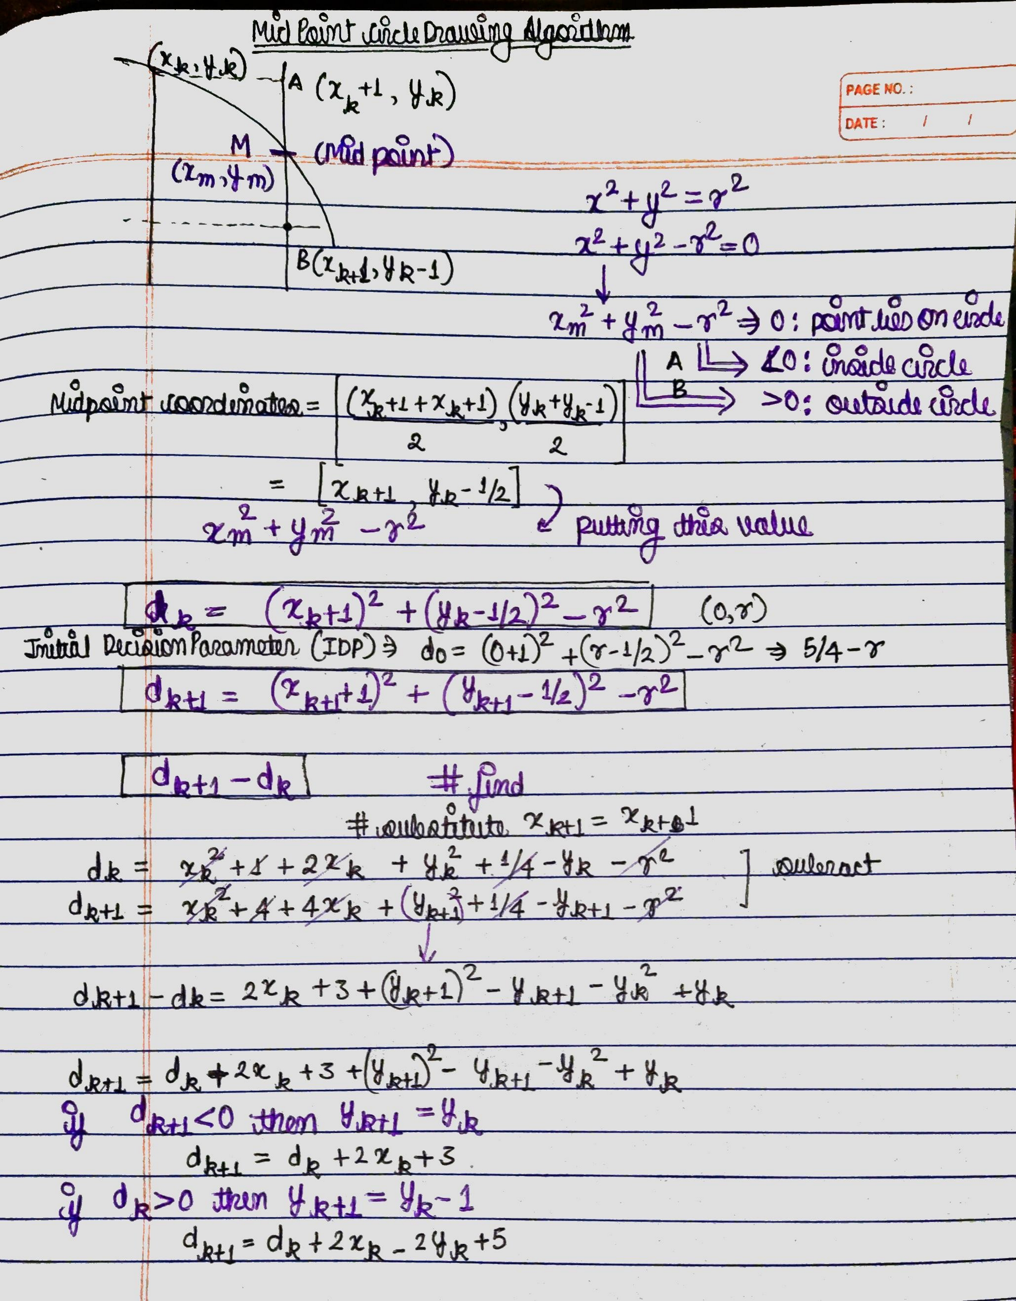









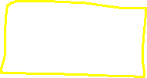

Mid Point Circle

Slide 29



Brensenham Circle

Slide 30
Mid Sem-Practical

Slide 31










void DDA(int x1, int y1, int x2, int y2){ int dx= x2-x1; int dy= y2-y1; int steps= dx>=dy? abs(dx):abs(dy); float xinc= dx/(float)steps; float yinc= dy/(float)steps; int i= 0; cout<<xinc<<'\t'<<yinc<<endl; cout<<"\nThe consequent coordinates are: "<<endl; int x= x1, y=y1; cout<< "x0: "<<x<<", y0:"<<y<<endl; while (i<=steps) // while (i<=10) { /* code */ putpixel(x, y, RED); x+=xinc; y+=yinc; i++; cout<< "x_next: "<<x<<", y_next:"<<y<<endl; } putpixel(x, y, RED); }

Slide 32
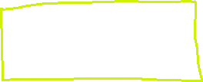


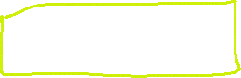



void brensanham(int x0, int y0, int x1, int y1){ int x=x0; int y=y0; if (x0 > x1) { x = x1; y = y1; x1 = x0; y1 = y0; x0 = x; y0 = y; } int dx= x1-x0; int dy= y1-y0; int p= 2*dy-dx; while(x<x1){ if(p>=0){ putpixel(x,y,WHITE); y=y+1; p=p+2*dy-2*dx; } else{ putpixel(x,y,WHITE); p=p+2*dy; } x=x+1; } }

Slide 33











void drawMidPointCircle(int x0, int y0, int radius){ int y = radius, x = 0; int decisionParam = 1 - radius; while (x <= y) { putpixel(x0 + x, y0 + y, 1); putpixel(x0 - x, y0 + y, 2); putpixel(x0 + x, y0 - y, 3); putpixel(x0 - x, y0 - y, 4); putpixel(x0 + y, y0 + x, 5); putpixel(x0 - y, y0 + x, 6); putpixel(x0 + y, y0 - x, 7); putpixel(x0 - y, y0 - x, 8); delay(400); x++; if (decisionParam <= 0) decisionParam += 2 *x + 1; else{ y--; decisionParam += 2 * (x-y) + 1; } } }

Slide 34






void drawBrensanhamCircle(int x0, int y0, int radius){ int x = 0, y = radius; int decisionParam = 3 - 2 * radius; while (x <= y) { putpixel(x0 + x, y0 + y, RED); putpixel(x0 + y, y0 + x, RED); putpixel(x0 - y, y0 + x, RED); putpixel(x0 - x, y0 + y, RED); putpixel(x0 - x, y0 - y, RED); putpixel(x0 - y, y0 - x, RED); putpixel(x0 + y, y0 - x, RED); putpixel(x0 + x, y0 - y, RED); if (decisionParam <= 0){ x++; decisionParam += 4 * x + 6; } else{ x++; y--; decisionParam += 4 * (x - y) + 10; } } }

Slide 35
Traffic Light
void drawTrafficLight(int x, int y, int lightSize, bool isRedOn, bool isYellowOn, bool isGreenOn){
// Draw black background
setfillstyle(SOLID_FILL, BLACK);
bar(x, y, x + lightSize, y + 3 * lightSize);
// Draw red light
setfillstyle(SOLID_FILL, isRedOn ? RED : DARKGRAY);
circle(x + lightSize / 2, y + lightSize / 2, lightSize / 2);
floodfill(x + lightSize / 2, y + lightSize / 2, WHITE);
// Draw yellow light
setfillstyle(SOLID_FILL, isYellowOn ? YELLOW : DARKGRAY);
circle(x + lightSize / 2, y + lightSize + lightSize / 2, lightSize / 2);
floodfill(x + lightSize / 2, y + lightSize + lightSize / 2, WHITE);
// Draw green light
setfillstyle(SOLID_FILL, isGreenOn ? GREEN : DARKGRAY);
circle(x + lightSize / 2, y + 2 * lightSize + lightSize / 2, lightSize / 2);
floodfill(x + lightSize / 2, y + 2 * lightSize + lightSize / 2, WHITE);
}

Slide 36
Smiley
#include <graphics.h>
int main(){
// draw graphics using graphics.h
int gDriver = DETECT, gMode;
initgraph(&gDriver, &gMode, NULL);
// draw a circle
circle(200, 200, 100);
// draw a smile
arc(200, 200, 210, 330, 50);
// draw eyes
circle(170, 180, 5);
circle(230, 180, 5);
// draw a nose
line(200, 200, 200, 230);
getch();
closegraph();
return 0;
}

Slide 37
Hut
#include<graphics.h> int main(){
// draw a hut
int gDriver = DETECT, gMode;
initgraph(&gDriver, &gMode, NULL);
// draw a rectangle
rectangle(100, 100, 300, 300);
// draw a triangle
line(100, 100, 200, 50);
line(200, 50, 300, 100);
line(100, 100, 300, 100);
// draw a door
rectangle(150, 230, 200, 300);
circle(150, 150, 30);
circle(250, 150, 30);
getch();
closegraph();
return 0;
}

